Slide 1

Analysis of Doctors Visit
ASWANTH E,
ID: 172663295366ea53f910591
Sri Venkateswara institute of Science and technology,
M.E, CSE.

Slide 2

PROBLEM STATEMENT
Objective: To analyze doctor visit data to uncover trends, patterns, and key insights that can enhance decision-making.
Key Questions:
What are the common factors affecting doctor visit trends?
How can we predict patient turnout more accurately?
Are there patterns in no-shows, rescheduling, or cancellations?

Slide 3
Project Description
Overview: The project focuses on analyzing patterns in doctor visit data to identify trends and enhance healthcare decision-making.
Key Challenges: Inefficient scheduling, high patient wait times, and underutilized resources in healthcare facilities.
Objective: To optimize patient flow, predict visit frequencies, and understand factors influencing appointment adherence.
Approach: Use data analytics techniques like trend analysis, predictive modeling, and visualization.
Impact: Improved patient satisfaction, reduced costs, and efficient healthcare delivery systems.

Slide 4

WHO ARE THE END USERS?
Healthcare Providers: Doctors, nurses, and clinic administrators use insights to improve patient care and operational efficiency.
Hospital Management: Helps make strategic decisions regarding resource allocation and patient flow management.
Public Health Agencies: Utilize data to identify health trends and manage community health initiatives.
Patients: Benefit indirectly through enhanced services and personalized care plans.
Researchers/Analysts: Leverage data for academic studies, trend analysis, and policy development.

Slide 5

Technology Used
Python: For data cleaning, analysis, and visualization.
Python package : numpy ,pandas, seaborns,
Excel: For quick data summaries and initial exploration.(dataset.csv)
Matplotlib & Seaborn: Advanced data visualizations in Python.
Git/GitHub: Collaboration and tracking changes in code.
Jupyter Notebooks: Sharing insights and code..

Slide 6
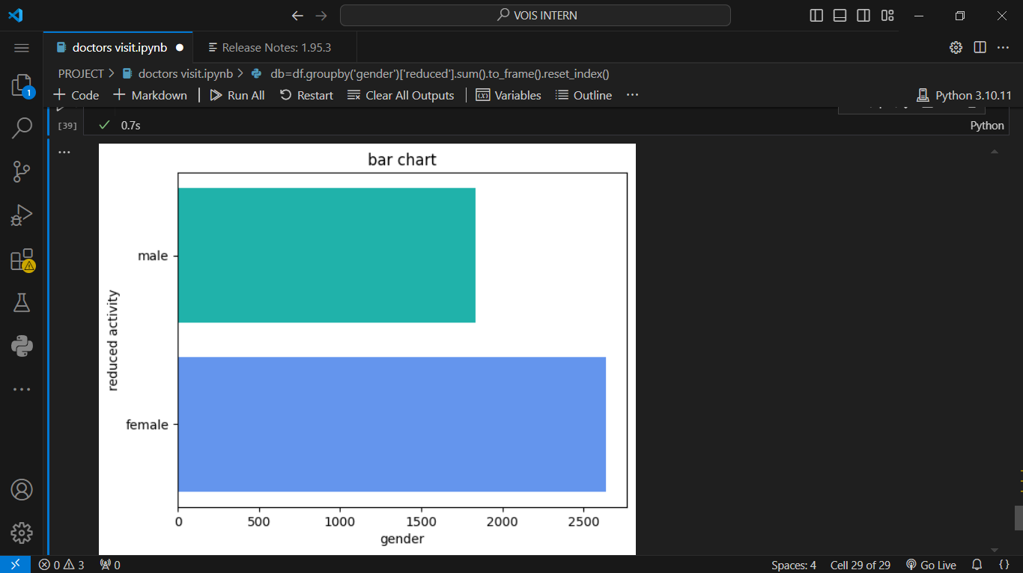
RESULTS
Demo Link

Slide 7
Thank you
.
.

